Slide 1





Windows Phone 8 Data, From Design to Cloud
Nick Randolph
nick@pixelandsons.com
@btroam
Notes:
Welcome to Windows Phone 8, more than an app.

Slide 2

Windows Phone 8 – Data
Working with Data
Design time data
Local data
Cloud data
Synchronization

Slide 3

App Scenario
Defect capture application
Defect Attributes
Photo
Title
Defect Type
Severity
Defect Types
Must Work Offline!

Slide 4

App Architecture
SQLite
12:38
SQL Azure
WAMS
Blob Storage
Isolated Storage
Notes:
Server side:
- Windows Azure Mobile Service (WAMS) [ Existing or New SQL Azure database)
- Blob Storage – for defect images [readonly, so need SAS in order to write)
Client side
Needs to persist Defect Types (pulled incrementally from server) and New Defects
SQLite for persistent store
Isolated storage for local persistence of defect image (db is actually in isolated storage too)

Slide 5
Internal Architecture
View
Main Page
Add Defect Page
View Model
+
Model
Main ViewModel
Add Defect View Model
Repository
Isolated Storage
Sqlite
WAMS
Notes:
Pages
Main Page – lists new defects that haven’t been syncd
Add Defect Page – used to add a new defect
View Models
Data is displayed using data binding
View Models share a single instance of the Repository
Repository
Handles saving data to isolated storage
Handles accessing (read/write) to Sqlite db
Also administers the synchronisation of data with WAMS
WAMS
Observe the disconnect between the UI layers and connectivity to WAMS
Synchronisation is a background operation which should seldom involve the user (in this case we can’t have conflicts as data is either pull (Defect Types) or push (Defects))
If doing full sync – need mechanism for user to resolve conflicts

Slide 6
Design time data
Main Page – read only list of data
Defects (Title, Photo, Severity)
Add Defect Page – edit controls
New Defect
Defect Types (Name)

Slide 7
Data binding
Declarative mark-up
Propagate change from View Model/Model to View
Deliver changes back to View Model/Model
Changes
INotifyPropertyChanged
INotifyCollectionChanged

Slide 8
Data binding
Text="{Binding Title}"
Source="{Binding Photo}"
ItemsSource="{Binding Defects}"

Slide 9
Data binding
Converters
Change colour of items in main list based on defect level (0-10)
Modes
Edit controls typically require two way
Background="{Binding Severity, Converter={StaticResource SeverityColorConverter}}"
Text="{Binding NewDefect.Title, Mode=TwoWay}"

Slide 10
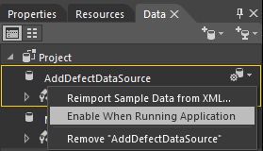
Run time data
Note: Disable design time data in Blend

Slide 11
MVVM
View Model
Represents current state of the UI
Logic only (no reference to UI, only data binding)
Testable
Reusable across platforms (WP 7/8, Win8… others)

Slide 12
Repository & ViewModel Locator
Repository
Shared Database and service access abstraction
Locator
Creates appropriate view model
Initialises it with reference to repository.

Slide 13
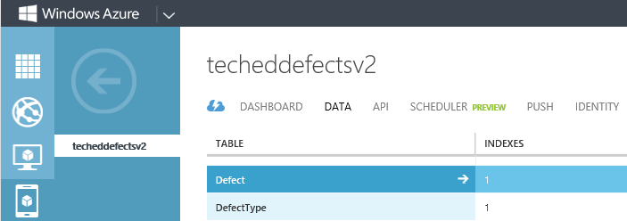
WAMS – Service
Tables
Defect Types (read only list)
Defects

Slide 14
WAMS – client
Retrieve defect types
Post new defects

Slide 15
Occasionally Connected/Disconnected
Requires offline capabilities
Read/Write locally
Synchronise as required

Slide 16
Caching
Cache defect types
Incremental download
New Defects
Uploaded as part of Sync
Local copy deleted

Slide 17
Sqlite
Extension/Update
Native to Managed bridge
Sqlite-net
Note: For PCL, Sqlite-net needs to be wrapped using interfaces with platform implementation

Slide 18
Synchronising
Bi-directional Sync
(eg Defect status will change)
Need UniqueId – Guid
Need LastUpdated – Date
Need IsDeleted - bool

